Slide 1
Analytix Assurance
Ironhack
Week 2 Quest

Slide 2
This Presentation
01
03
02
04
Business Problem
Data Cleaning
Exploratory Data Analysis
Conclusions

Slide 3
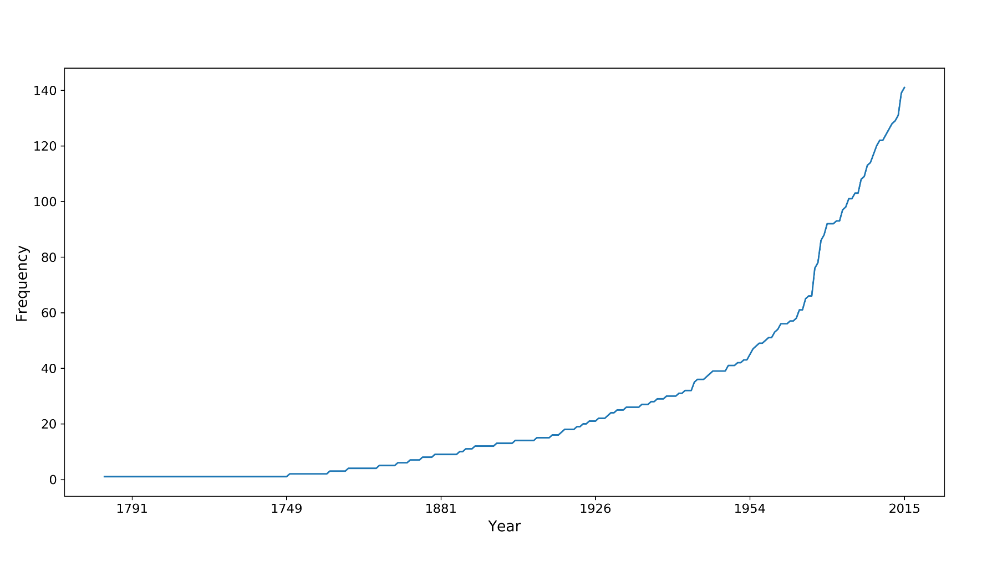

01
Business Problem
Yearly Evolution of Shark Attacks
Analytics Assurance is losing money on travel insurance accounts with clients who engage in water activities in high risk areas.

Slide 4
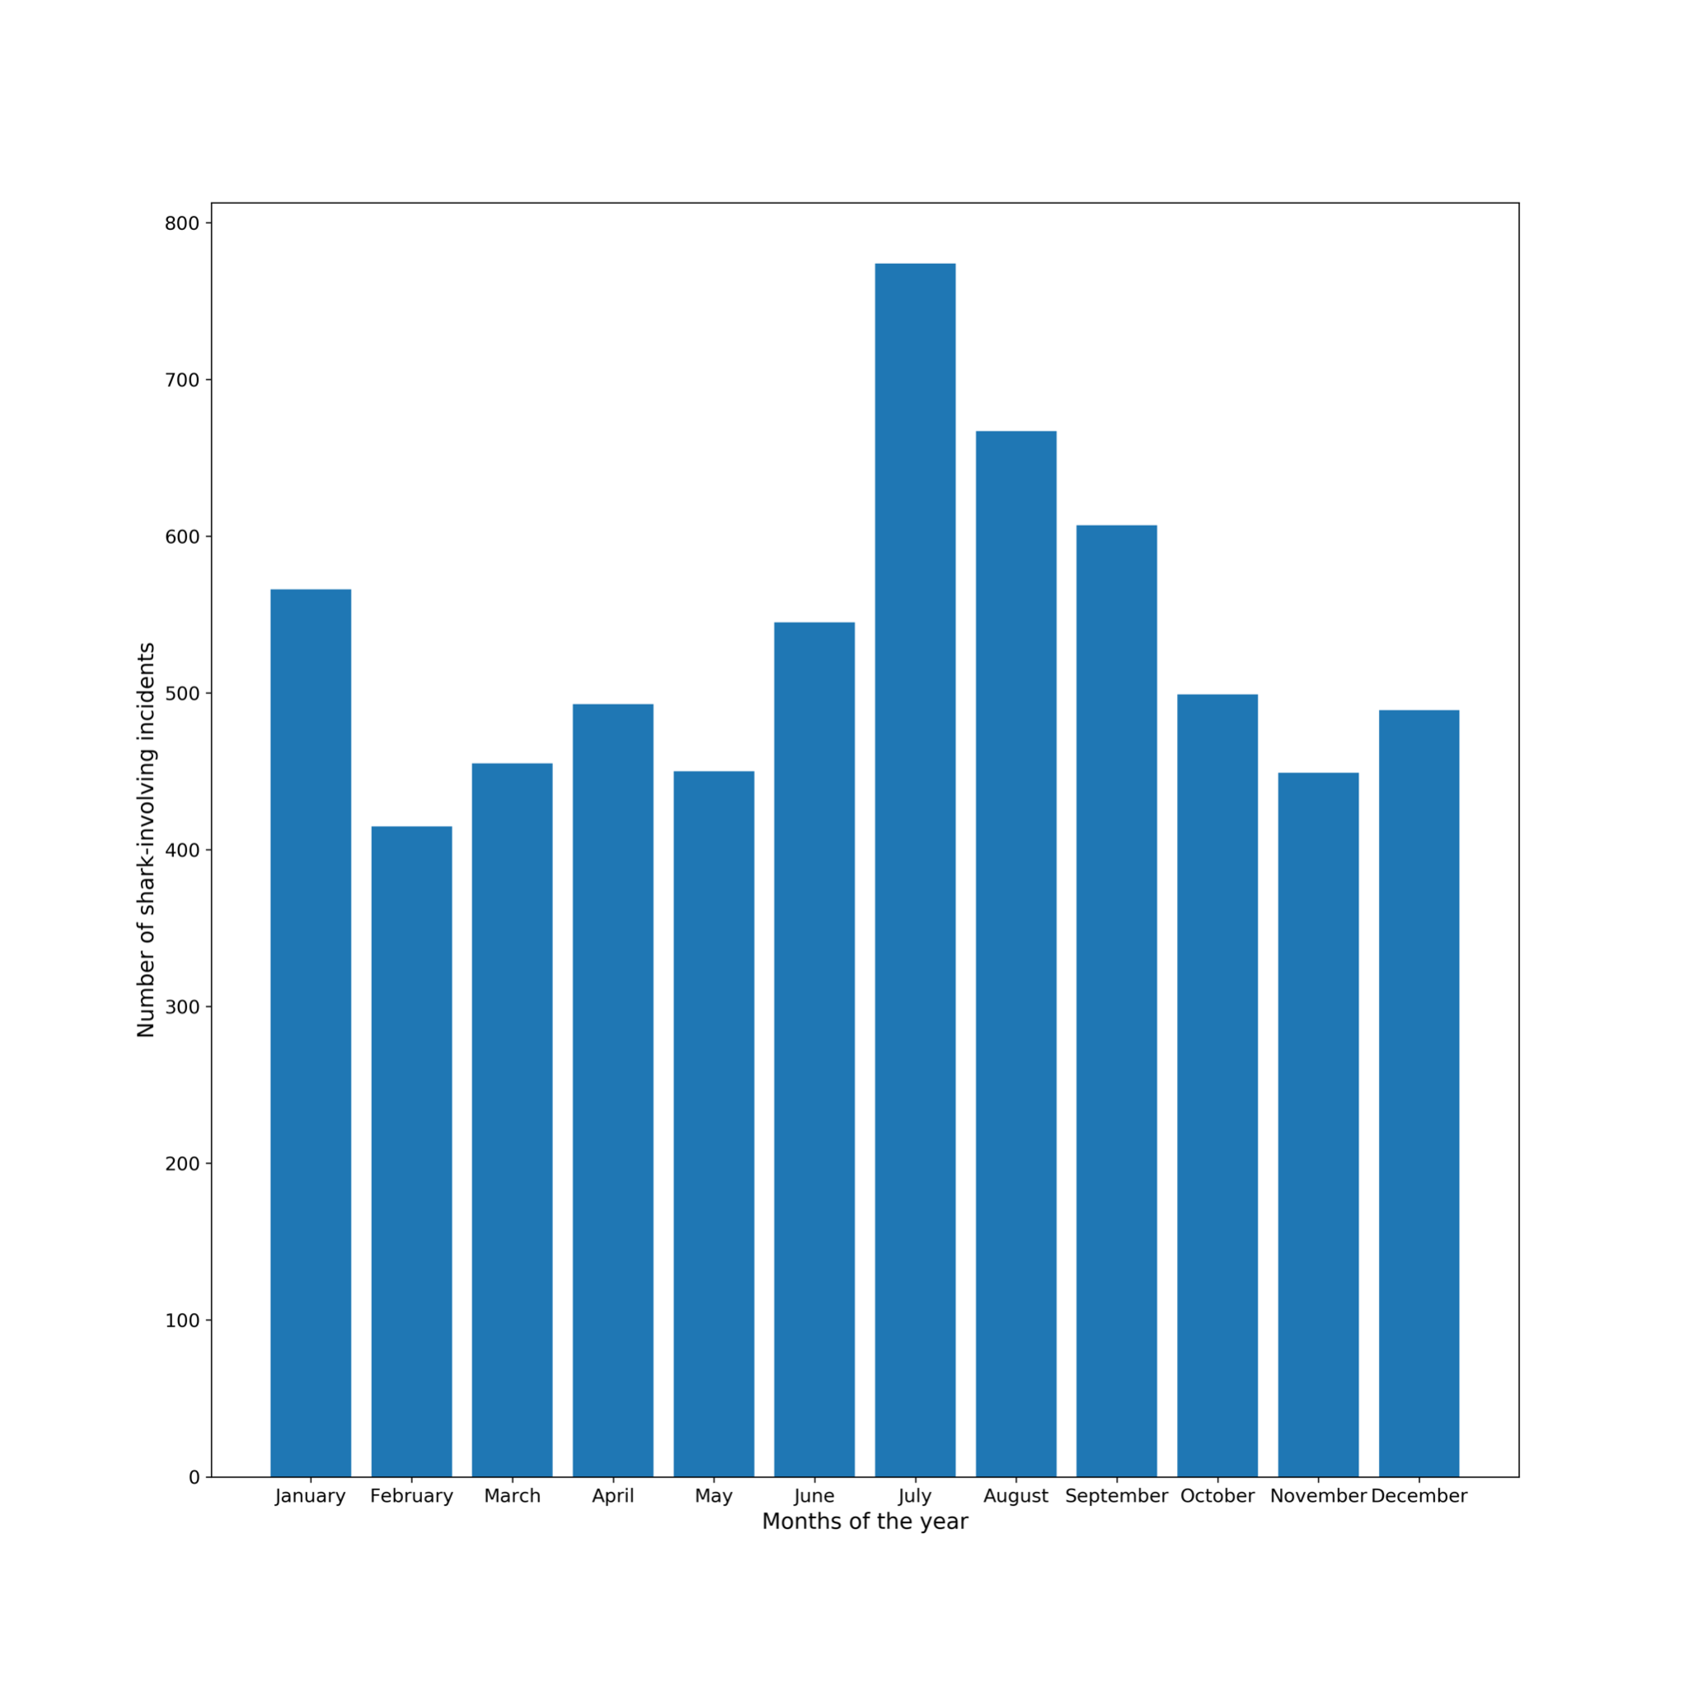
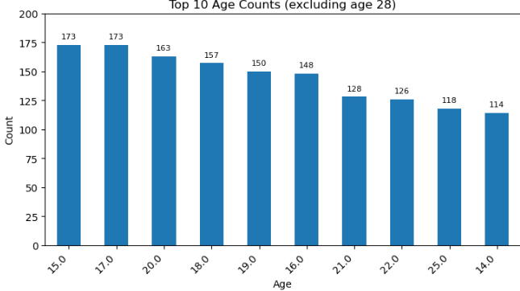
02
Which clients are risky?
Attacks by Month
Attacks by Age

Slide 5
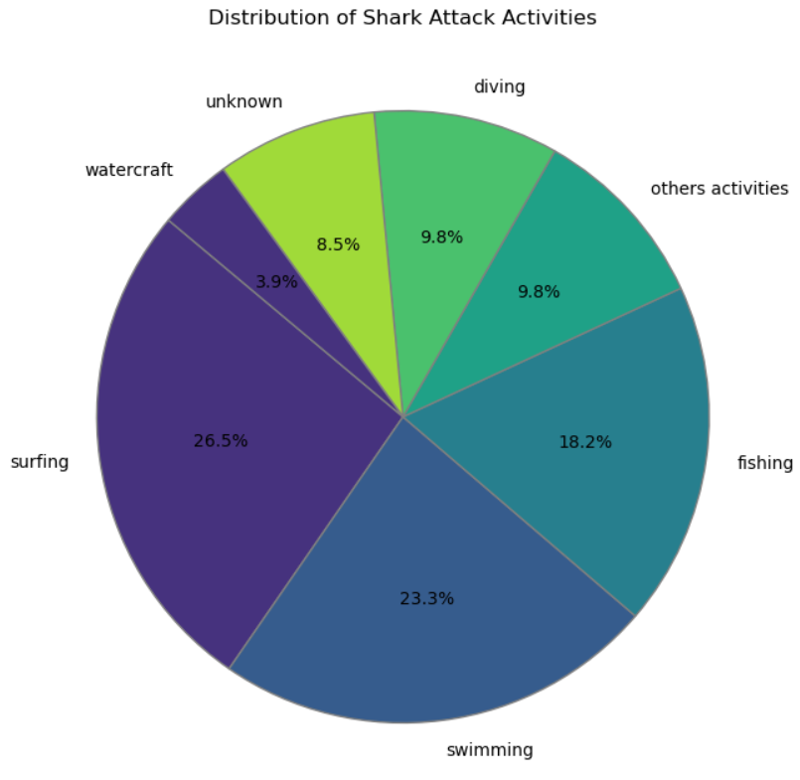
02
Which activities are risky?
Surfing
Swimming
Fishing
Diving

Slide 6
02
Opportunity?
Assessment of risk profiles to develop specialized insurance products.

Slide 7
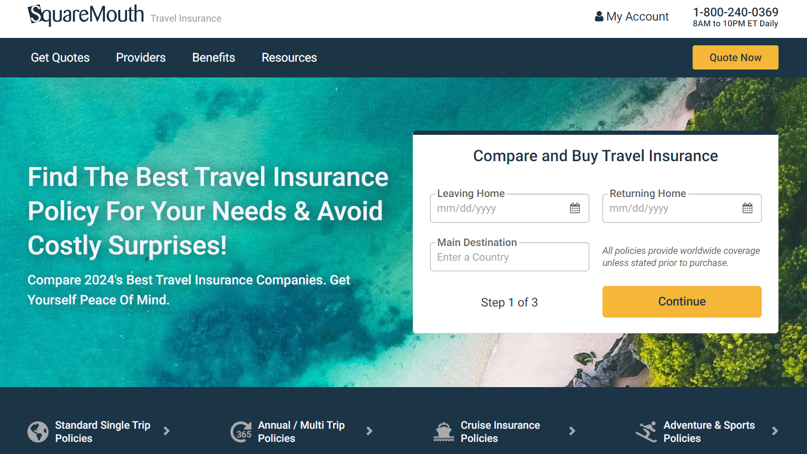
03
MVP
Analytix Assurance
Data:
Shark attacks
Travel insurance claims
EDA:
Attacks & insurance claims by location & time
Correlations: high-attack areas, high-accident locations, high-accident times of year

Slide 8
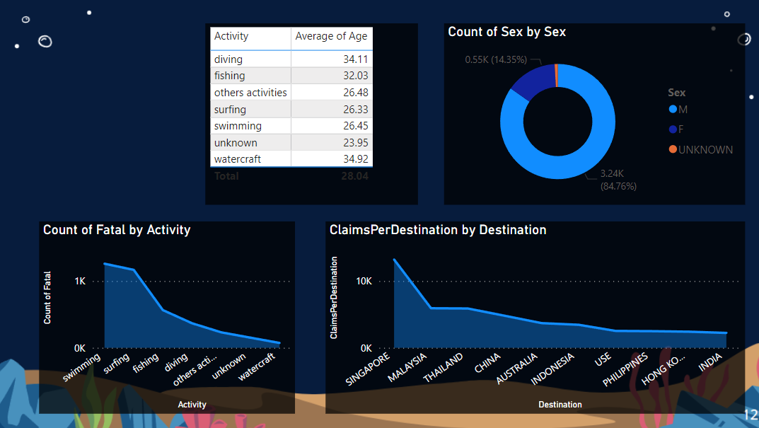
03
Dashboard
Analytix Assurance

Slide 9
03
Data Cleaning
Organization
Columns
To do list
What to do
What not to do
Fill missing values with 'unknown'
Standardize text format
Remove leading and trailing spaces

Slide 10
04
Conclusions
Peak Times
July / August & December / January
Activities & Locations
Swimming, Surfing, Fishing / USA,AU
Number of Attacks
On increase throughout the years
Different Asr. Packages
Coverages differ from group to another

Slide 11



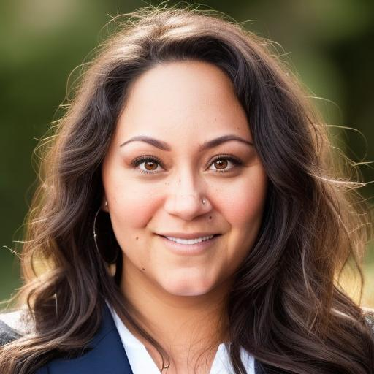
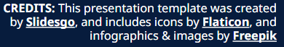
Thank You!
Reda Rerizani
Mariona Tarragó
Armen Houspess
Darcee Caron

